Slide 1

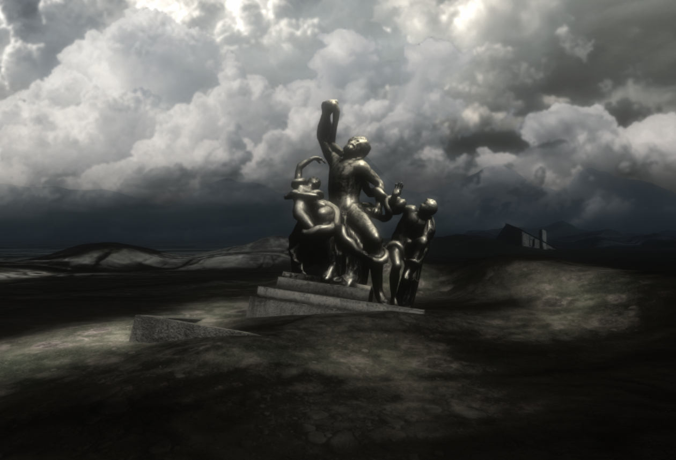


Noto: the day of fear (1693)
A VR immersive project about the legacy of resilience
Elisa Bonacini
University of South Florida
Sebastiano Deva
AppTripper

Slide 2

NEW DIGITAL EXPERIENCES IN A CHANGING WORLD
The diffusion of new technologies has given rise to the spread of information and improvement in quality as well as evolving the way people enjoy museums, culture and cities.
New technologies are improving both cultural and tourist strategies and people’s enjoyment of cultural opportunities such as museums, archaeological sites and art collections and, in general, culture.

Slide 3
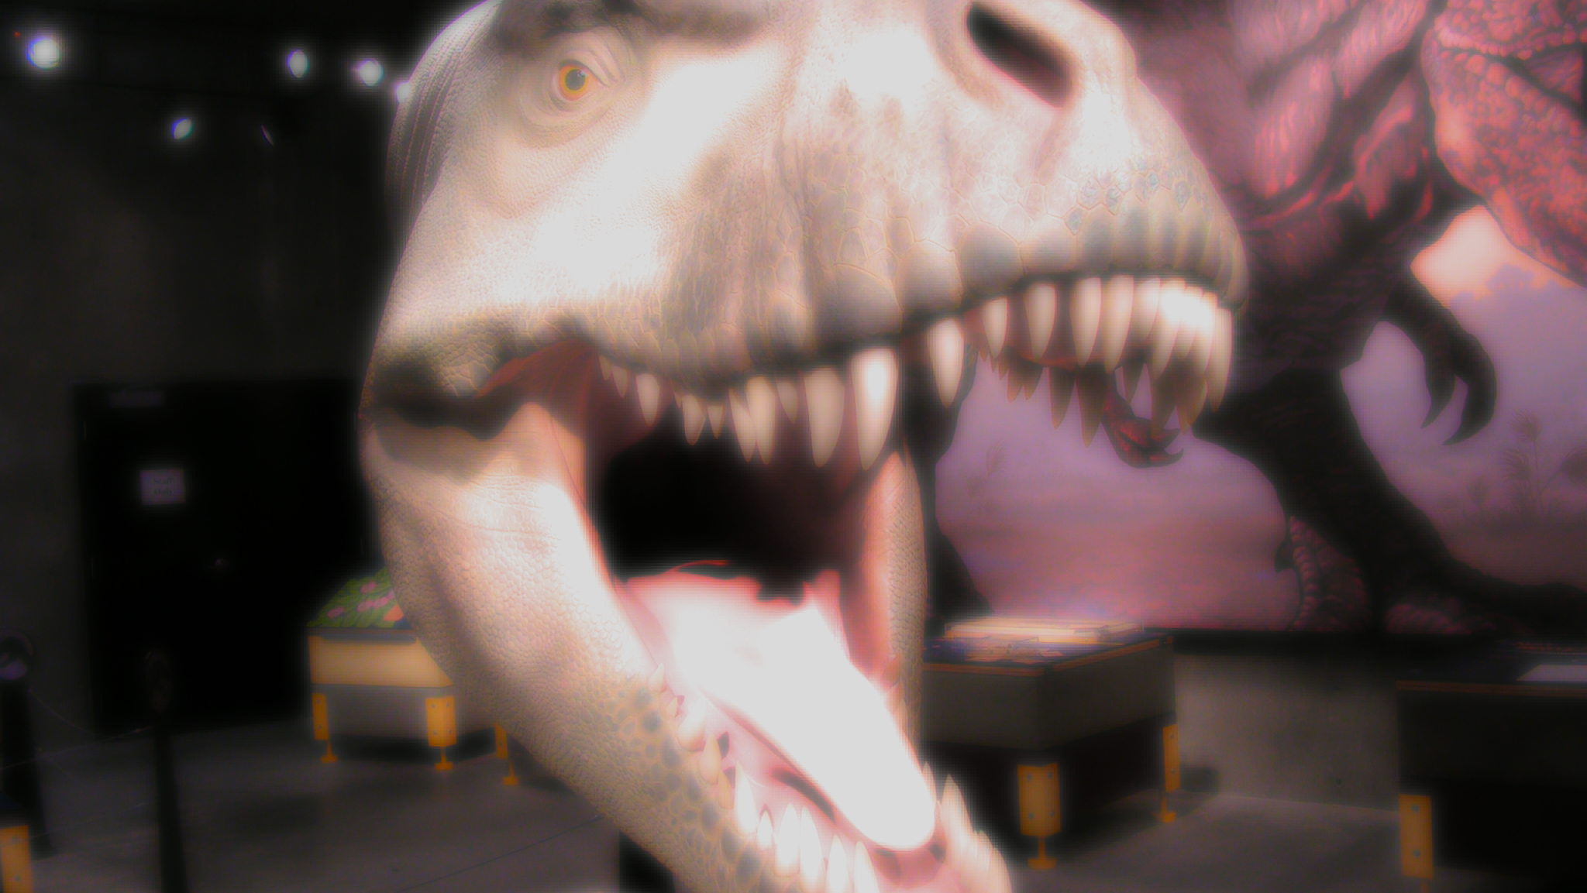
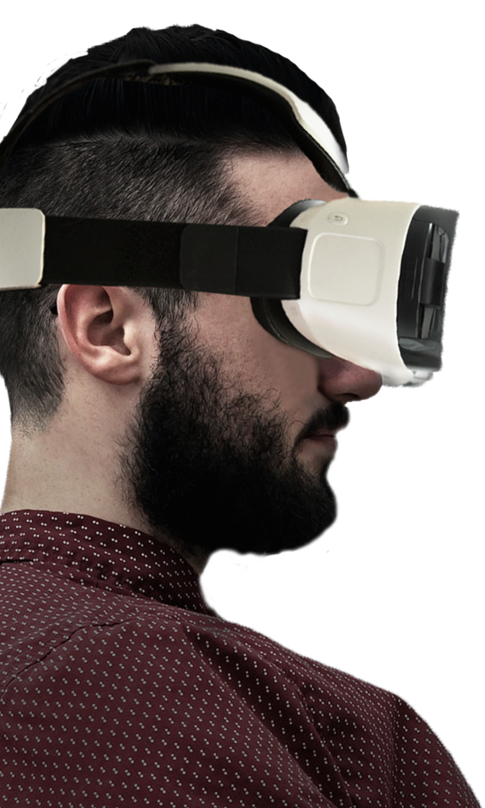
NEW DIGITAL EXPERIENCES IN A CHANGING WORLD
AR and VR applications and experiences are among the most popular and innovative audience engagement solutions and their use has recently increased.
Organizations are searching for new ways to exploit the potential of these technologies to enhance the visitor’s experience from home or in situ.
The COVI-19 pandemic has brought about incredible advances in the development of VR in the simulation of real-life experiences.

Slide 4
NEW DIGITAL EXPERIENCES IN A CHANGING WORLD
Story-based narratives provide experiences which let users understand both cultural heritage and history thanks to more stimulating cognitive and emotional processes.
Digital storytelling has therefore been considered very useful in the enhancement and fruition of a cultural heritage and visitors’ engagement.

Slide 5
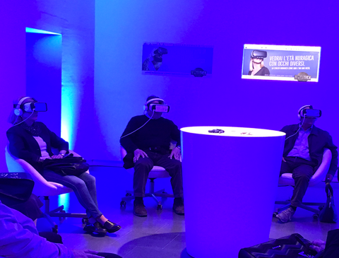
NOTO THE DAY OF FEAR (1693)
AN EMOTIONAL VR TRIP INTO THE PAST
VR storytelling experiences revealed their importance in encouraging visitors’ engagement not only through VR reconstructions but also on the evocative and emotional storytelling of events and contexts.
The VR immersive storytelling movie is focusing on the Noto’s last moments during the1693 earthquake.

Slide 6
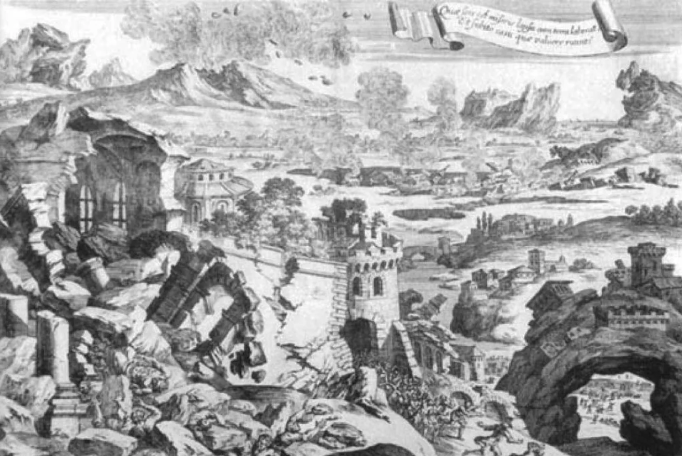
NOTO THE DAY OF FEAR (1693)
THE HISTORICAL CONTEXT
On January 11th 1693 the Val di Noto region, in the South-east of Sicily, was struck by a major earthquake, around 20:30/21:00 local time (corresponding with today’s 1.30 pm).
The shock was devasting: nearly 70 urban centres were partially or entirely destroyed and about 60,000 people died.

Slide 7
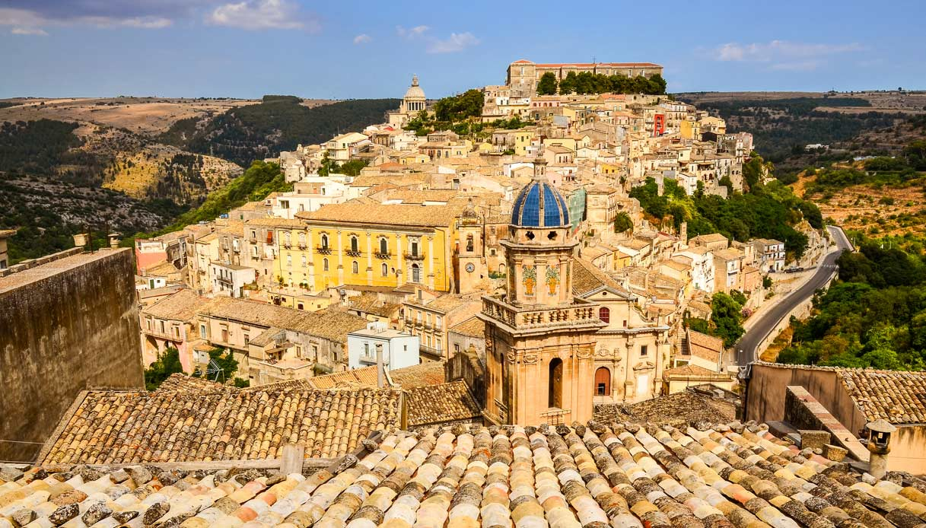
NOTO THE DAY OF FEAR (1693)
THE HISTORICAL CONTEXT
Following this event, the new city was founded, and new houses, palaces, churches and monasteries were built in a Late Baroque style.
All 9 Late Baroque towns of Sicily, built after1693, were included in the UNESCO WHL in 2005.

Slide 8
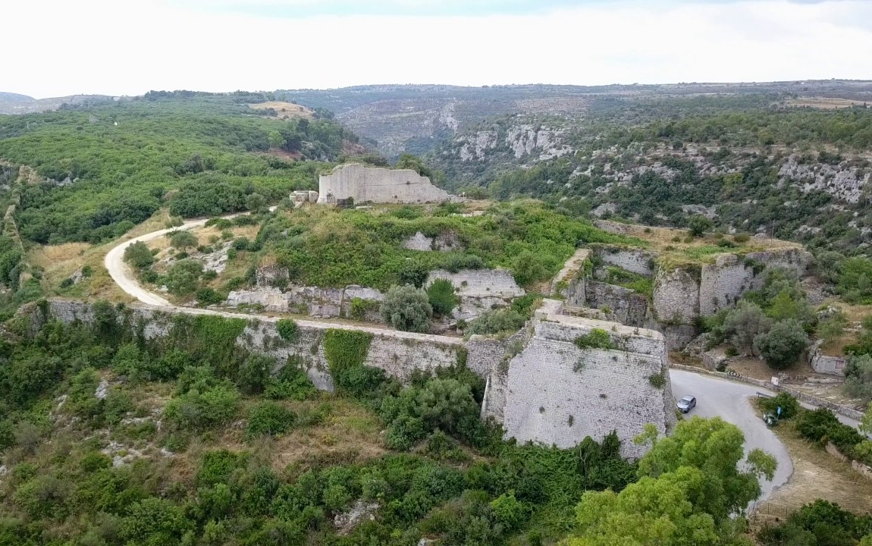
NOTO THE DAY OF FEAR (1693)
THE HISTORICAL CONTEXT
Among the destroyed cities, Noto Antica was seriously damaged, and after years of discussing where to rebuild the city, they decided to build a new town, abandoning the old one.

Slide 9

NOTO THE DAY OF FEAR (1693)
THE VR IMMERSIVE EVOCATIVE STORYTELLING PROPOSAL
The project was born from the idea of recreating the last moments of Noto Antica, seen through the eyes of the protagonists and based on historical and scientific references.
An important aspect of the project was that it should involve the participation of both the local scientific heritage community and Noto’s living heritage community, in keeping with the Faro Convention.

Slide 10
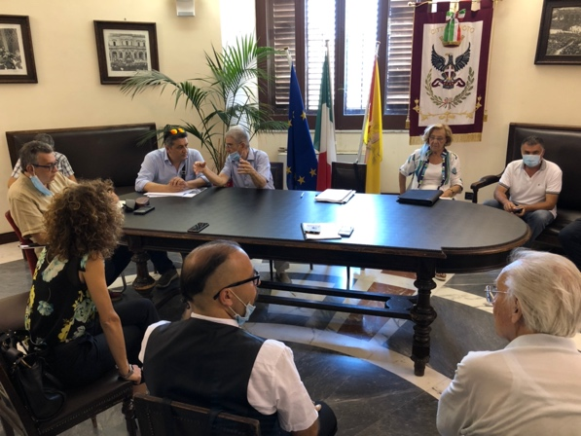
NOTO THE DAY OF FEAR (1693)
THE PARTICIPATORY PRODUCTION PROCESS: THE COMMITTEE OF EXPERTS
A committee of experts was established.
The editorial project was shared with the committee, then the screenplay, thus ensuring a participatory reviewing process of the scenes to be digitally recreated.
They contributed in providing data, scientific references, comparisons, in order to guarantee the philological adherence for both the digital reconstruction of the urban landscape and the one of the citizens.

Slide 11
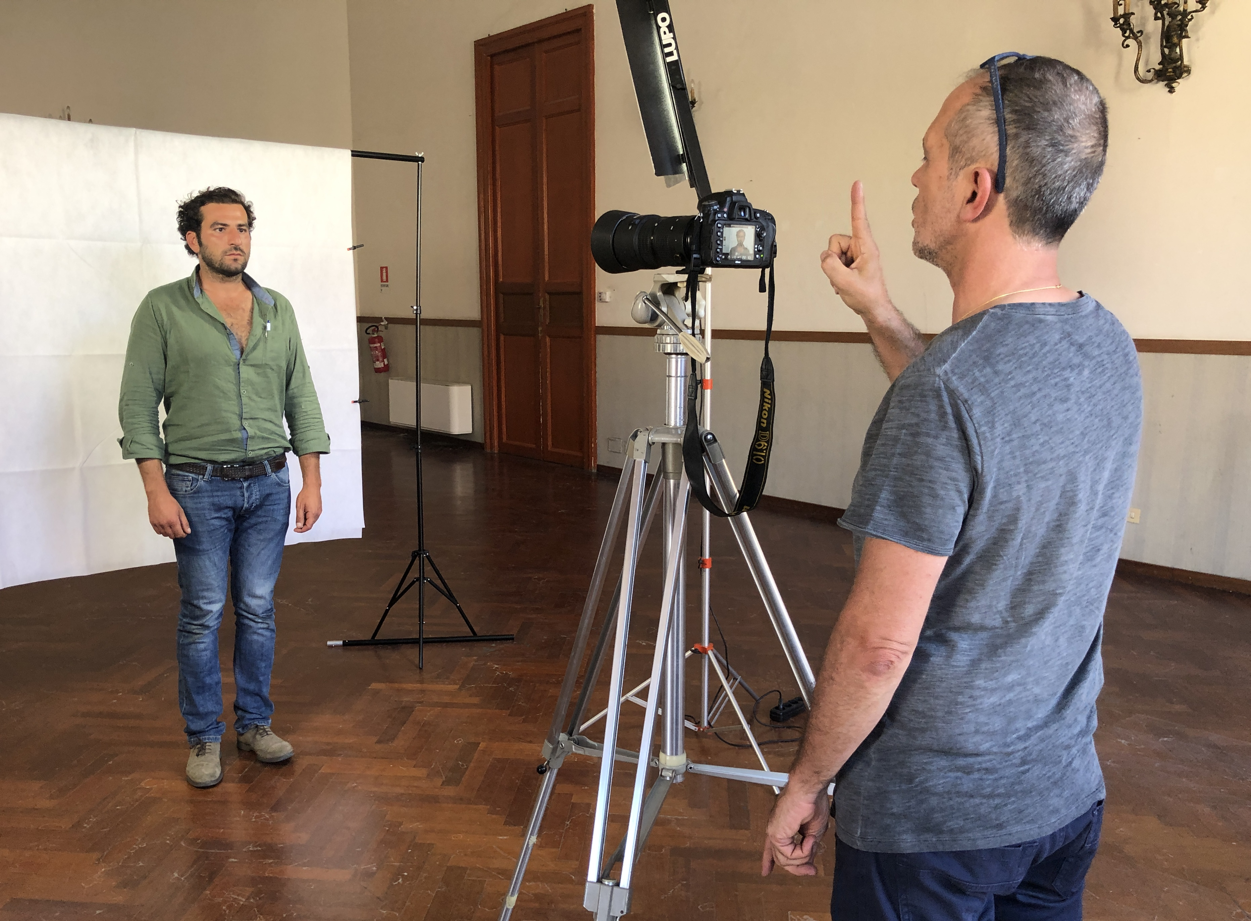
NOTO THE DAY OF FEAR (1693)
THE PARTICIPATORY PRODUCTION PROCESS: THE 3D CASTING OF LOCAL PEOPLE
The 3D modelling of some digital characters, through the rendering of the true faces of the citizens of today’s Noto, was made through a “digital casting” of 130 volunteers.

Slide 12
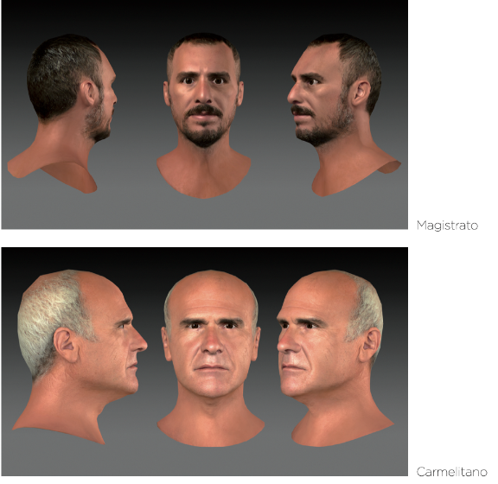
NOTO THE DAY OF FEAR (1693)
THE PARTICIPATORY PRODUCTION PROCESS: THE 3D CASTING OF LOCAL PEOPLE
20 people were selected and digitally replicated in 20 3D characters, who all have a real-life counterpart.
Thanks to visual references and photos, the 3d models were rebuilt and painted with different techniques.

Slide 13
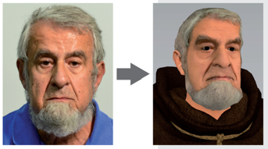
NOTO THE DAY OF FEAR (1693)
THE PARTICIPATORY PRODUCTION PROCESS: THE 3D CASTING OF LOCAL PEOPLE
The resulting character is thus far more realistic, by enhancing the historical protagonists with traits of real people.
People who can recognize themselves in the faces’ of the Captain of Justice, the Mayor, the Jesuit, the Prisoner or other characters from the crowd.
The Jesuit
Father Antonino Marescalco
A native old man from Noto

Slide 14
NOTO THE DAY OF FEAR (1693)
THE PARTICIPATORY PRODUCTION PROCESS: THE 3D RECONSTRUCTION OF PEOPLE
Thanks to 3D technologies, it was therefore possible to faithfully reconstruct the faces and somatic features of the characters, who were then associated with really existing people, with their social rules, dressed in keeping with XVII century fashion, as agreed by the scientific committee, in order to obtain convincing, charismatic figures, endowed with complexity and personality.

Slide 15
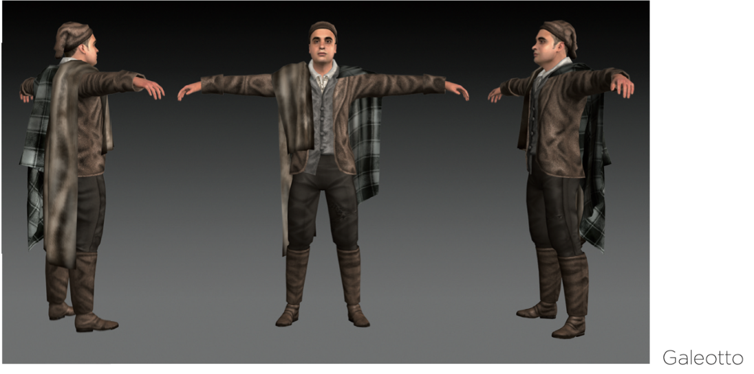
NOTO THE DAY OF FEAR (1693)
THE PARTICIPATORY PRODUCTION PROCESS: THE 3D RECONSTRUCTION OF PEOPLE

Slide 16
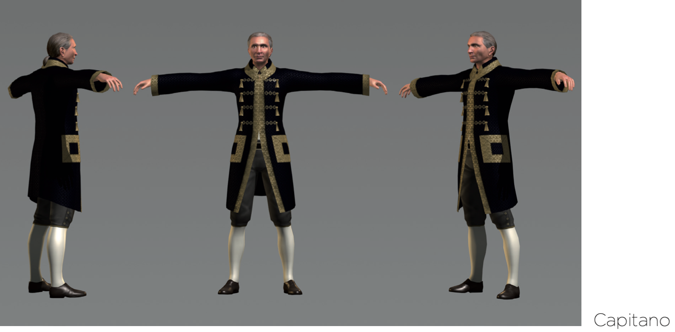
NOTO THE DAY OF FEAR (1693)
THE PARTICIPATORY PRODUCTION PROCESS: THE 3D RECONSTRUCTION OF PEOPLE

Slide 17
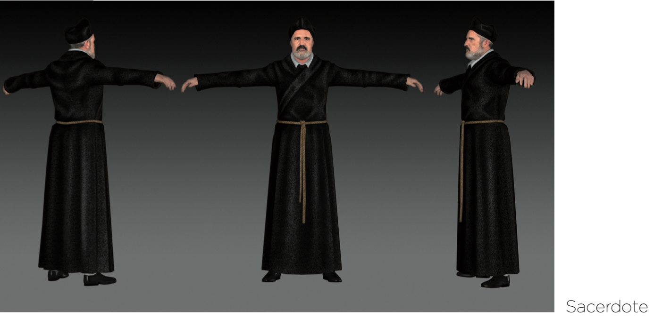
NOTO THE DAY OF FEAR (1693)
THE PARTICIPATORY PRODUCTION PROCESS: THE 3D RECONSTRUCTION OF PEOPLE

Slide 18
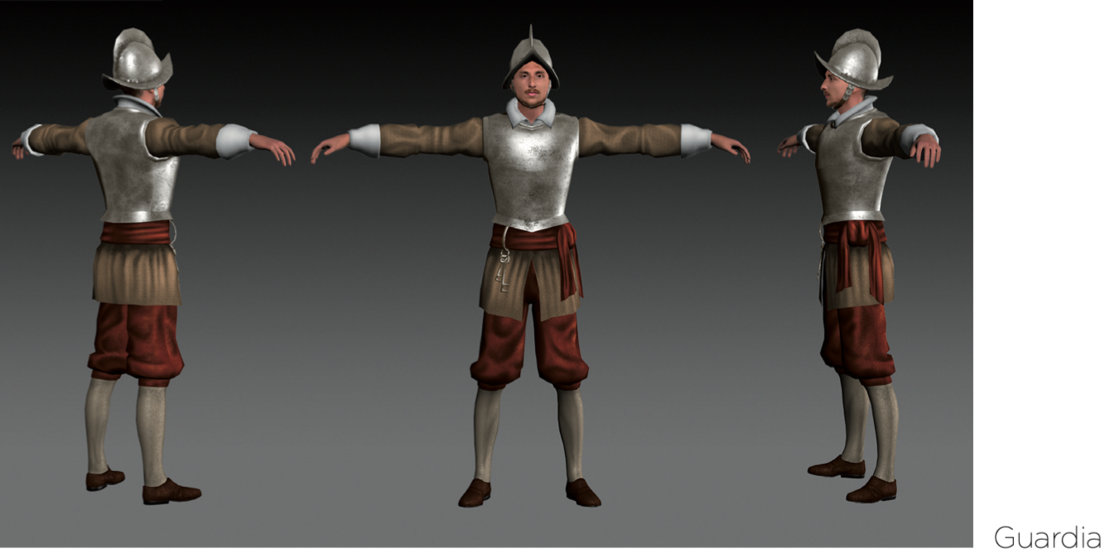
NOTO THE DAY OF FEAR (1693)
THE PARTICIPATORY PRODUCTION PROCESS: THE 3D RECONSTRUCTION OF PEOPLE

Slide 19
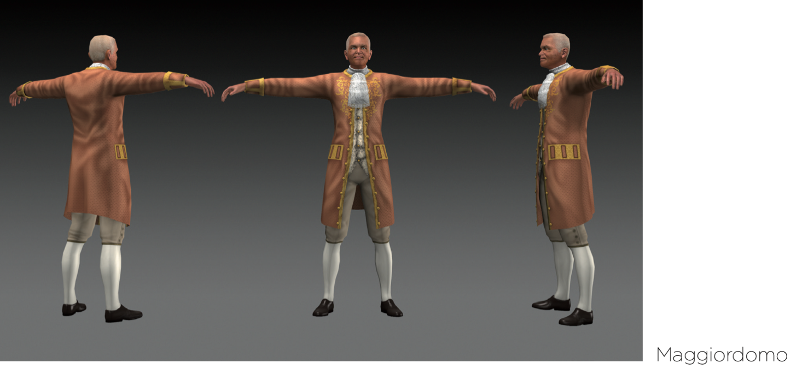
NOTO THE DAY OF FEAR (1693)
THE PARTICIPATORY PRODUCTION PROCESS: THE 3D RECONSTRUCTION OF PEOPLE

Slide 20
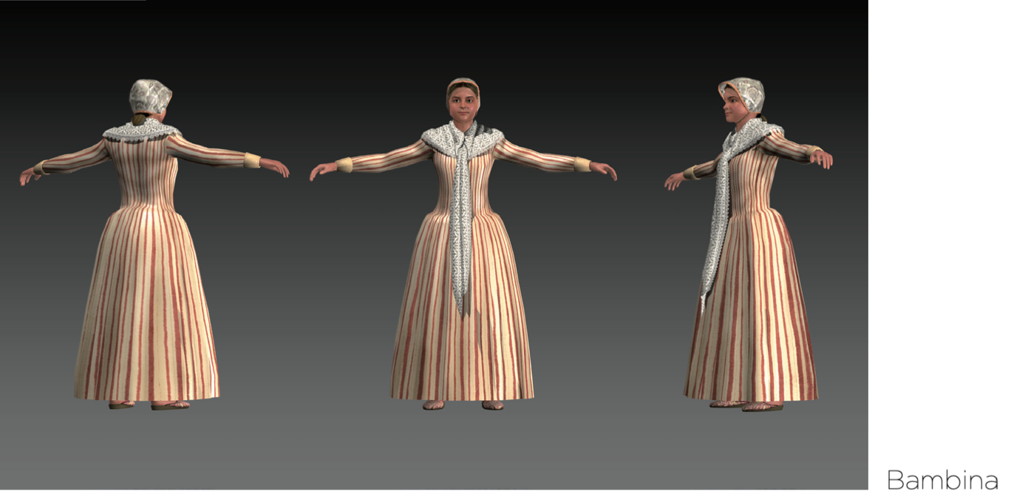
NOTO THE DAY OF FEAR (1693)
THE PARTICIPATORY PRODUCTION PROCESS: THE 3D RECONSTRUCTION OF PEOPLE

Slide 21
NOTO THE DAY OF FEAR (1693)
THE 3D RECONSTRUCTION OF THE CITY
In the texturing phase, all the urban and architectural elements have been reconstructed with a precise and evident note of general degradation (the city suffered much damage from the previous shocks), mixed with poor chromatic tones to simulate a veil of decadence, a suspension of the drama that is bearing down on people, buildings and objects.
Furthermore, the use of mixed cinematographic techniques (depth fogging, particle dynamics, colour correction, light painting) has therefore made it possible to generate a kind of “virtual fresco” for each environment.

Slide 22
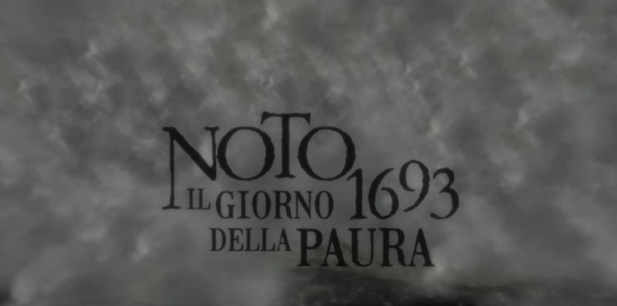
NOTO THE DAY OF FEAR (1693)
THE 3D MOVIE

Slide 23
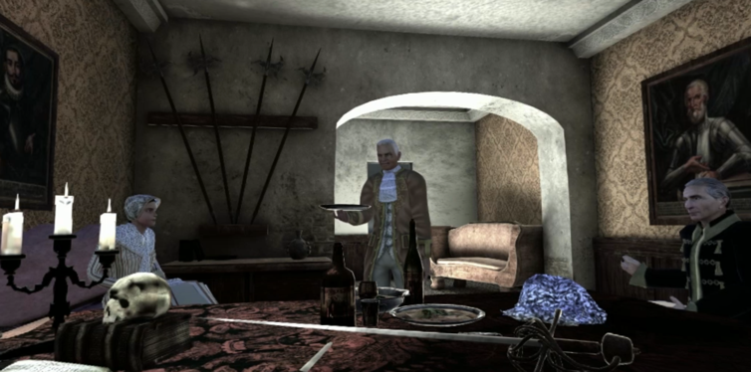
NOTO THE DAY OF FEAR (1693)
THE 3D MOVIE

Slide 24
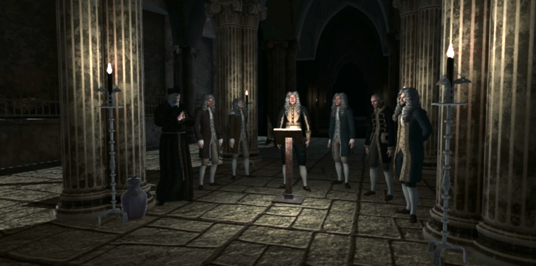
NOTO THE DAY OF FEAR (1693)
THE 3D MOVIE

Slide 25
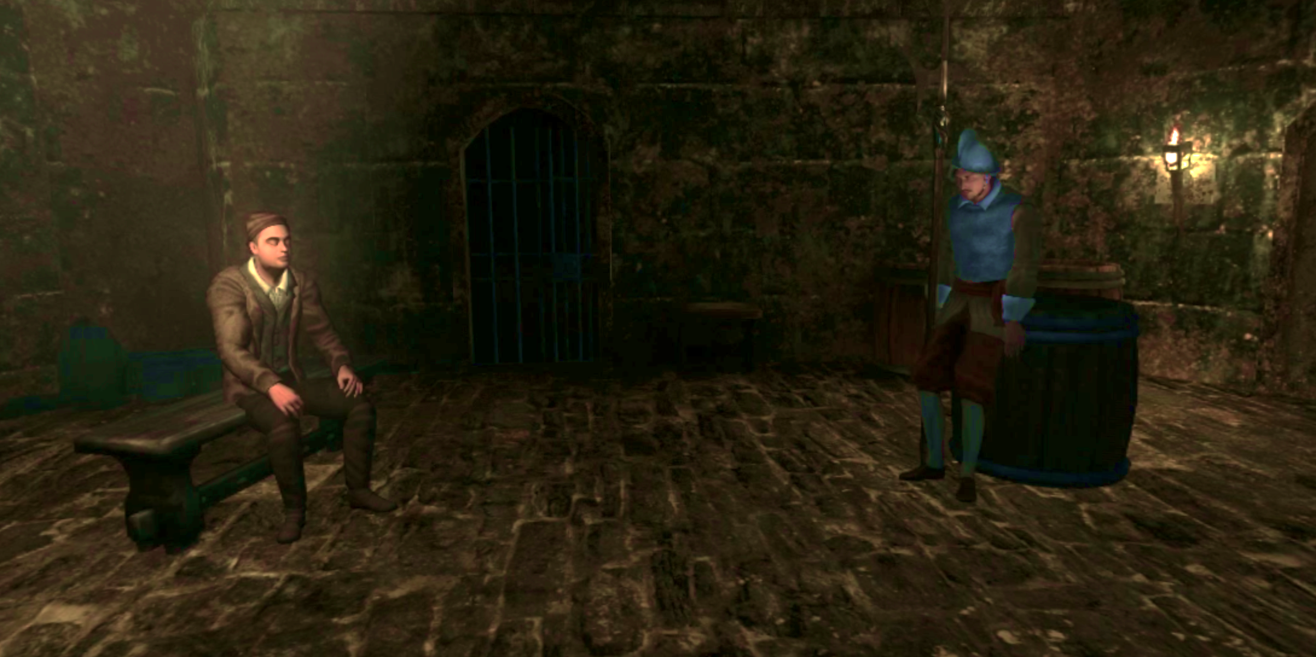
NOTO THE DAY OF FEAR (1693)
THE 3D MOVIE

Slide 26
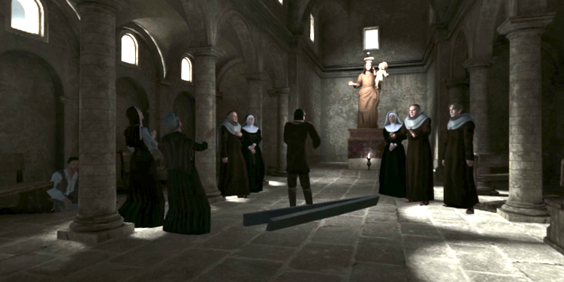
NOTO THE DAY OF FEAR (1693)
THE 3D MOVIE

Slide 27
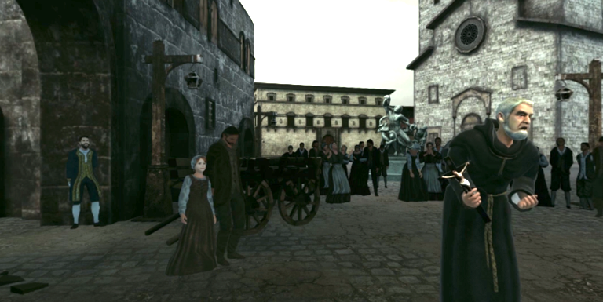
NOTO THE DAY OF FEAR (1693)
THE 3D MOVIE

Slide 28
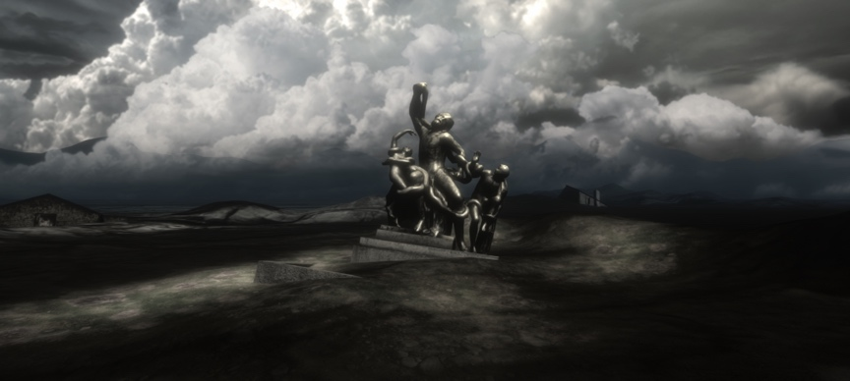
NOTO THE DAY OF FEAR (1693)
THE 3D MOVIE

Slide 29
NOTO THE DAY OF FEAR (1693)
THE EVOCATIVE STORYTELLING
From the emotional and evocative side, an external storyteller introduces the story in some scenes.
In parallel, in the case of the Mayor, the Prisoner and the Jesuit, voice actors were also involved: the three mentioned characters were also able to express themselves vocally, thanks to facial animation and lipsync techniques.

Slide 30
NOTO THE DAY OF FEAR (1693)
A BRIDGE ABOUT THE LEGACY OF RESILIENCE
A “digital bridge” between generations has been created to regain awareness of their ancient roots and the heritage communities which they all represent.
The VR project is remarkable for its participatory production process, involving local experts and citizens in rebuilding the last moment of Noto.
It is the very first VR immersive movie telling, from an emotional and evocative storytelling, of a recent human tragedy, such as an earthquake.
This process is evocative of the underlying concept of the narrative: the resilience that overcomes the drama and events and emerges from the ruins of the centuries.

Slide 31
Noto: the day of fear (1693)
A VR immersive project about the legacy of resilience
THANK YOU
Elisa Bonacini
University of South Florida
Sebastiano Deva
AppTripper

